Slide 1

PIP104 PROFESSIONAL PRACTICE-II
VIVA-VOCE
EARLY PREDICTION OF LIFESTYLE DISEASES USING MACHINE LEARNING
Batch Number: CSD-26
Roll Number | Student Name
20201CSD0153 | DEEKSHITH D L
20201CSD0182 | MITHUN R
20201CSD0187 | MADHUSHREE A
Under the Supervision of,
Mr. LAKSHMISHA S K
Assistant Professor
School of Computer Science Engineering & Information Science
Presidency University

Slide 2
Introduction
The ML Disease Prediction Web Application is a comprehensive solution designed to leverage machine learning techniques for predicting early lifestyle health conditions based on user-provided information.
The central component of the project is a user-friendly web application developed using Flask, allowing users to input their health-related details and receive real-time predictions about potential diseases.

Slide 3
Literature Review
"Machine Learning for Healthcare: On the Verge of a Major Shift in Healthcare Epidemiology" by Alaa M. Ahmed et al.
"Machine Learning in Medicine: A Practical Introduction" by Thomas H. McCoy Jr. et al.
"Machine Learning for Predictive Modeling of Health Outcomes" by Rajkomar et al.
A. Parab, P. Gholap and V. Patankar, "DiseaseLens: A Lifestyle related Disease Predictor," 2022 5th International Conference on Advances in Science and Technology (ICAST).
Xia Yu and Shuoyu Wang, "A Health Check and Prediction System for Lifestyle-Related Disease Prevention," First International Conference on Innovative Computing, Information and Control - Volume I (ICICIC'06).

Slide 4
Research Gaps Identified
Advantages | Limitations
Early Prediction | Limited Prediction Accuracy
cost Reduction | Dependency on Data Quality
Improved Patient Outcome | Ethical Consideration

Slide 5
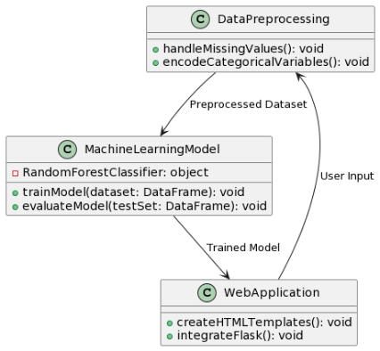
Proposed Methodology
Data Collection
Data Preprocessing
Machine Learning Model
Web Application

Slide 6



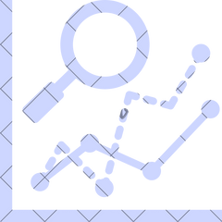




Objectives
Develop a machine learning model for predicting l i festyle diseases.
1
Enhance predictive
accuracy by incorporating advanced
features
2
3
Address privacy
concerns through secure data handling practices.
Evaluate the model' s effectiveness in a real-
world setting.
4

Slide 7
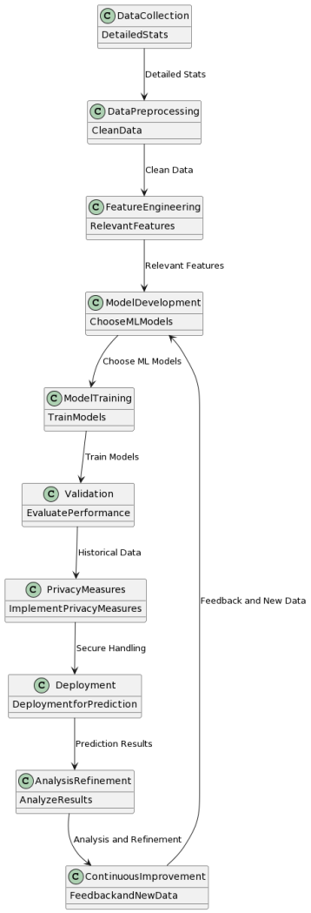
System Design & Implementation

Slide 8
System Design & Implementation

Slide 9
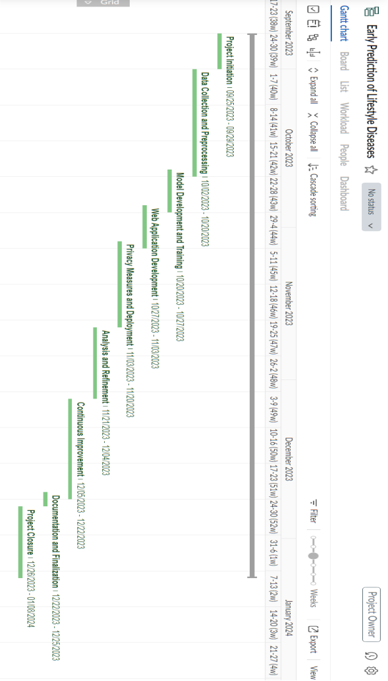
Timeline of Project

Slide 10
Outcomes / Results Obtained
The model demonstrated accurate predictions on the test dataset, achieving a high level of precision across multiple diseases. The web application successfully integrates with the trained model, providing users with instant predictions based on their input.
The machine learning model exhibited commendable performance during evaluation, showcasing its efficacy in predicting diseases accurately. The web application successfully facilitated user interactions, capturing health-related details and delivering predictions in a user-friendly manner.
Accuracy of 98.44%

Slide 11
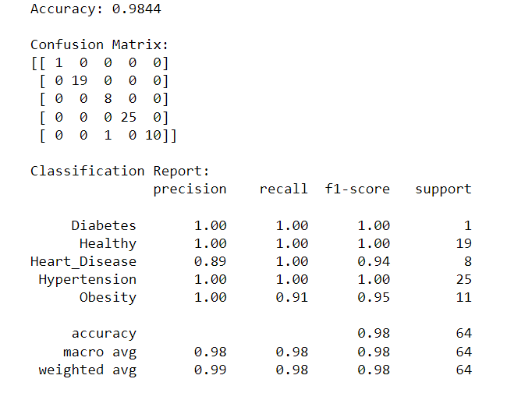
Outcomes

Slide 12
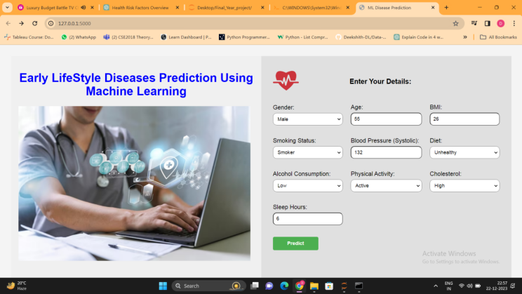
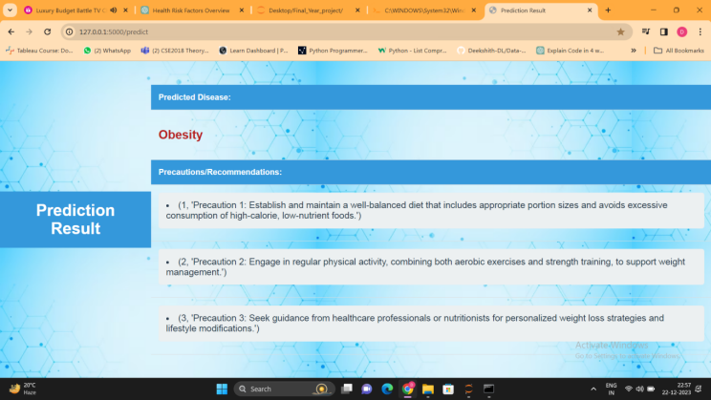
Outcomes:

Slide 13
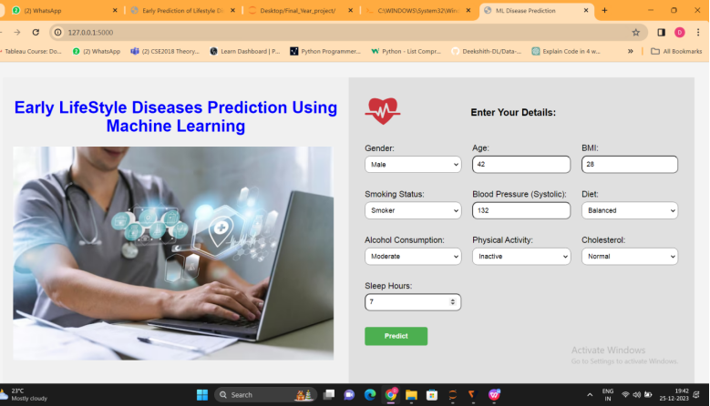
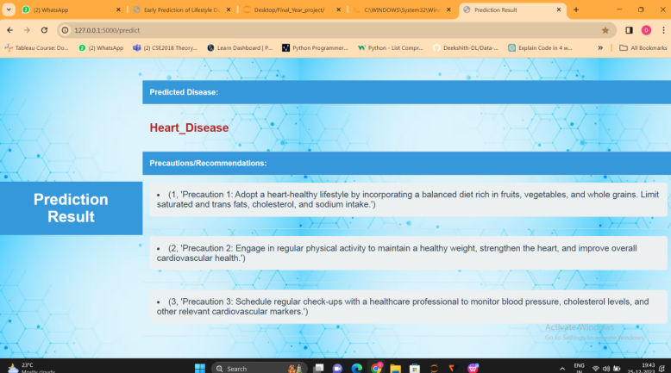
Test Cases-1: Heart_Diseases

Slide 14
Test Cases-2: Obesity

Slide 15
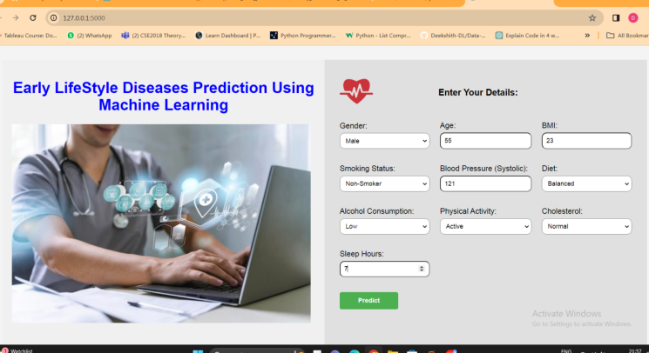
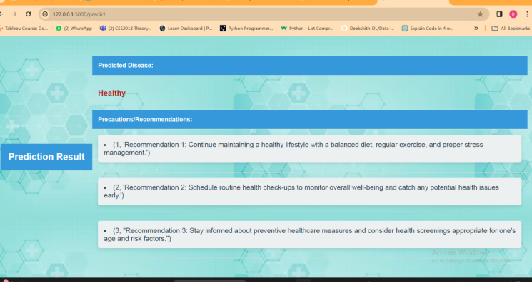
Test Cases-3: Healthy

Slide 16
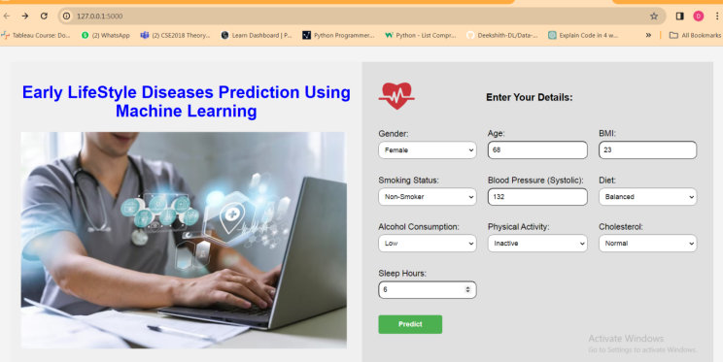
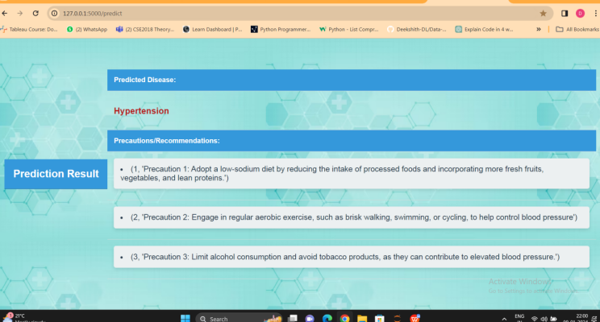
Test Cases-4: Hypertension

Slide 17
Conclusion
This project aims to significantly contribute to preventive healthcare by leveraging machine learning for early prediction of lifestyle diseases. l
Through comprehensive data analysis, the model is expected to provide accurate predictions, allowing for timely interventions and cost-effective healthcare.
The ML Disease Prediction Web Application provides users with a valuable tool to assess potential health risks based on lifestyle and health-related information. The integration of a powerful machine learning model with an intuitive web interface contributes to a user-friendly and informative health assessment experience.
In conclusion, the project successfully demonstrates the feasibility of developing a web application for disease prediction using machine learning. The integration of a predictive model into a user-friendly interface opens avenues for preventive healthcare and early intervention.

Slide 18
References
[1] A. Parab, P. Gholap and V. Patankar , "DiseaseLens: A Lifestyle related Disease Predictor," 2022 5th International Conference on Advances in Science and Technology (ICAST).
[2] Xia Yu and Shuoyu Wang, "A Health Check and Prediction System for Lifestyle-Related Disease Prevention," First International Conference on Innovative Computing, Information and Control - Volume I (ICICIC'06)
[3] M. Govindaraj, V. Asha, B. Saju, M. Sagar and Rahul, "Machine Learning Algorithms for Disease Prediction Analysis," 2023 5th International Conference on Smart Systems and Inventive Technology (ICSSIT)
[4] "Machine Learning for Healthcare: On the Verge of a Major Shift in Healthcare Epidemiology" by Alaa M. Ahmed et al.
[5] "Machine Learning in Medicine: A Practical Introduction" by Thomas H.McCoy Jr. et al.
[6] "Machine Learning for Predictive Modeling of Health Outcomes" by Rajkomar et al.
[7] PubMed Central (PMC) - Machine Learning and Healthcare Section. ·
[8] Scikit-learn Documentation https://scikit-learn.org/ ·
Flask Documentation https://flask.palletsprojects.com/

Slide 19
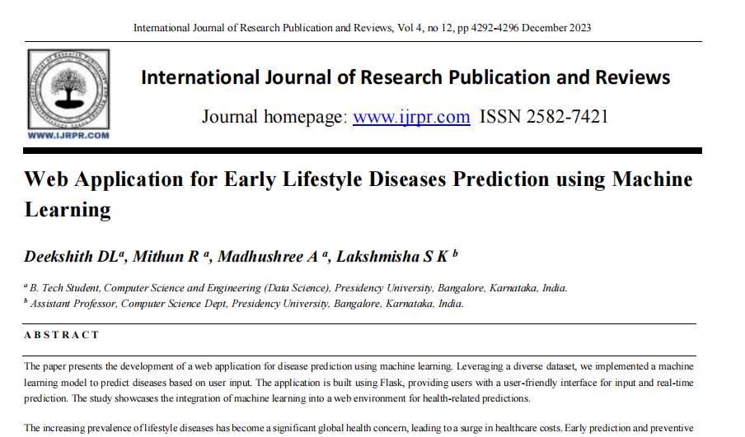
Publication Details

Slide 20
Publication Details
Paper Link:
https://ijrpr.com/uploads/V4ISSUE12/IJRPR20697.pdf
Github Link:
https://github.com/Deekshith-DL/ML-Early-LifeStyle-Diseases-Prediction-Web-App

Slide 21

Thank You

